Slide 1
PAK LAW AI
Consistency Checker For Pakistani Law
An AI-Powered Solution for Legal Document Analysis
Muhammad rohail
BCS231112
Syed Abdul Qahar
BCS231046
Noor ul Ain Sagheer
bcs223020
Supervisor: Dr. M. Abdul Qadir
Department: Computer Science
Spring 2026

Slide 2
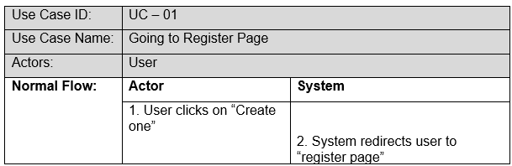
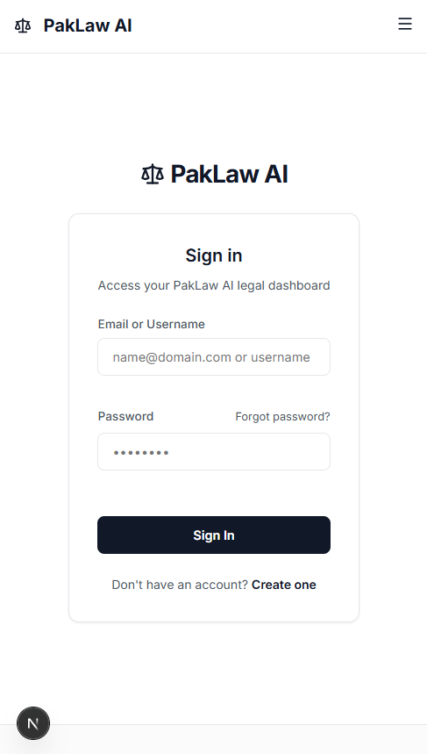
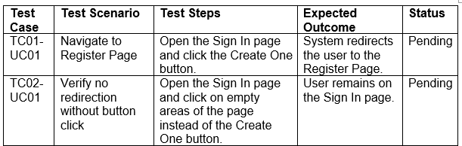
Use Case 01:
Tools and Tecnologies (for all):
Next js / react + Tailwind css
Python Backend
Firebase
Developer: Qahar

Slide 3
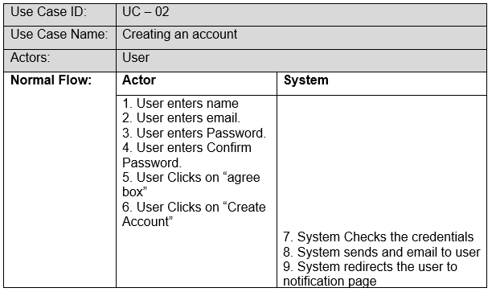
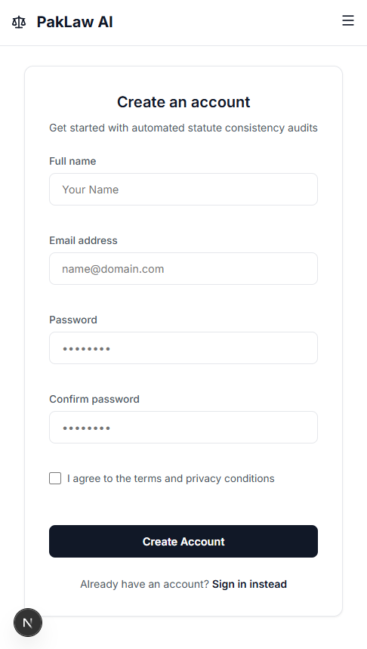
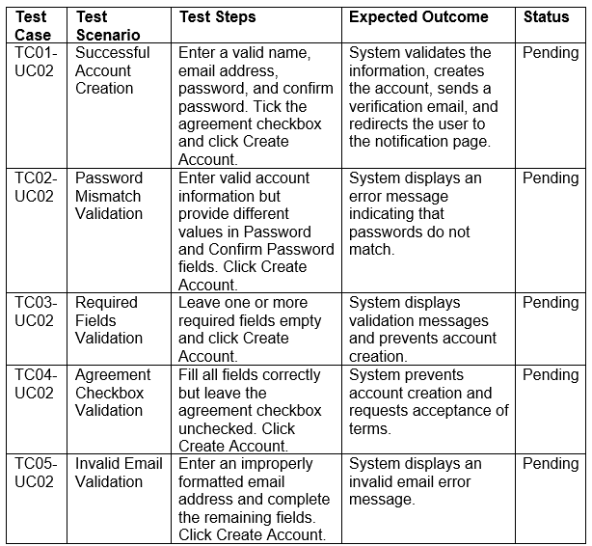
Use Case 02:
Developer: Qahar

Slide 4
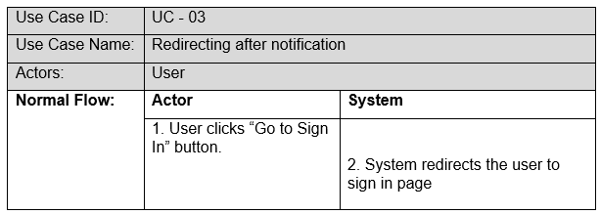
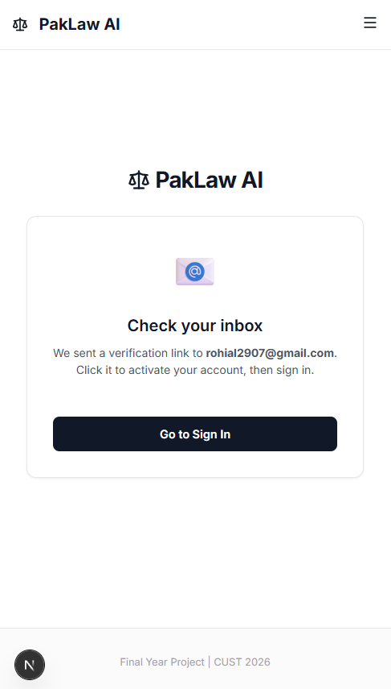
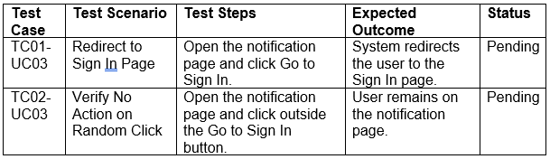
Use Case 03:
Developer: Qahar

Slide 5
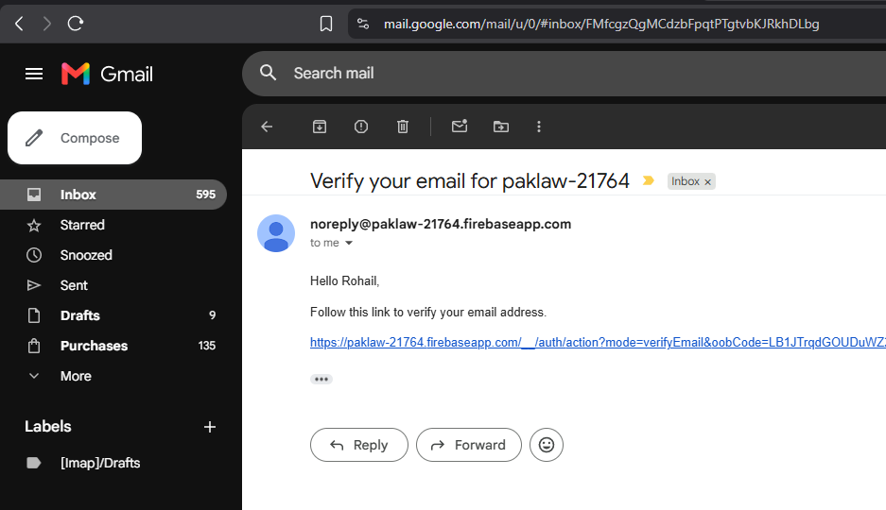
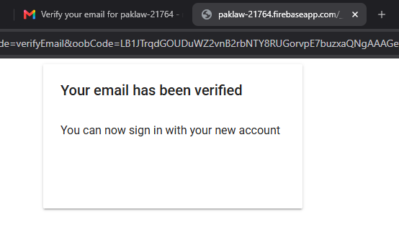
User Gmail:

Slide 6
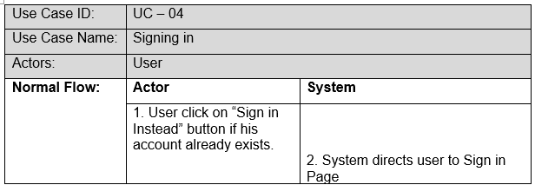
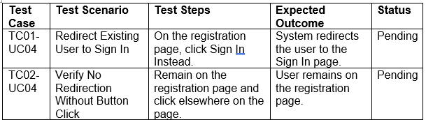
Use Case 04:
Developer: Qahar

Slide 7
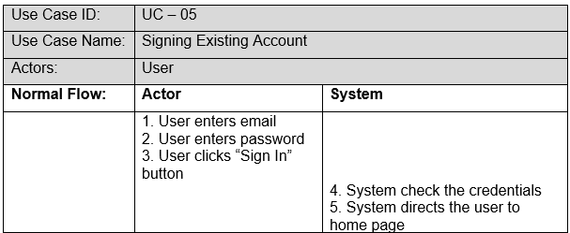
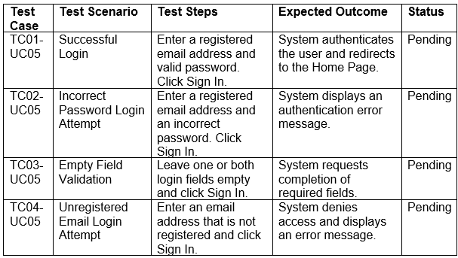
Use Case 05:
Developer: Qahar

Slide 8
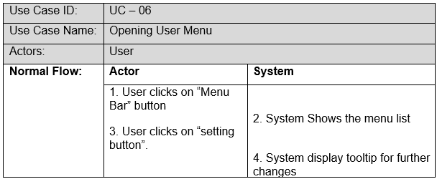
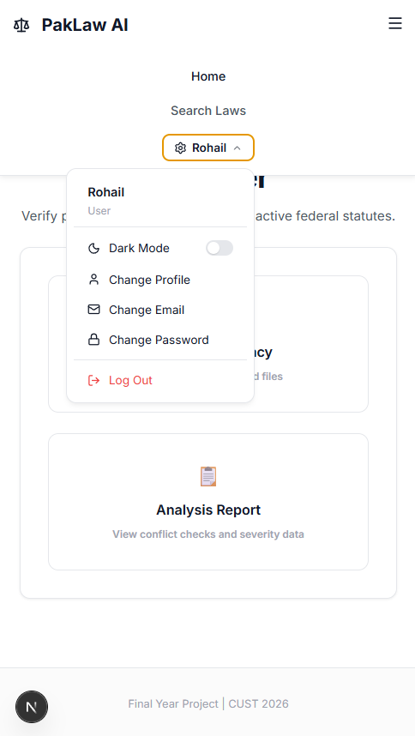
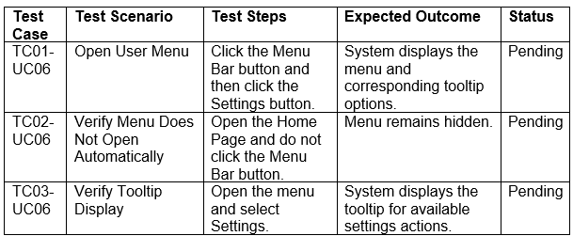
Use Case 06:
Developer: Qahar

Slide 9
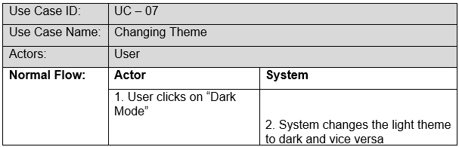
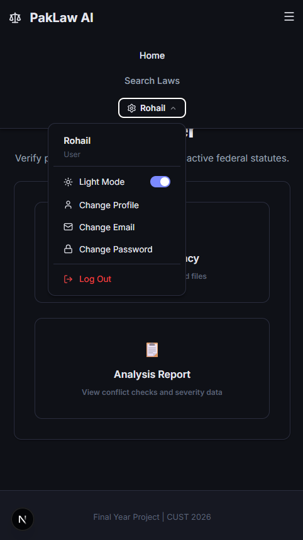
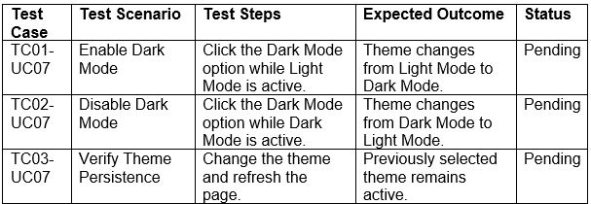
Use Case 07:
Developer: Qahar

Slide 10
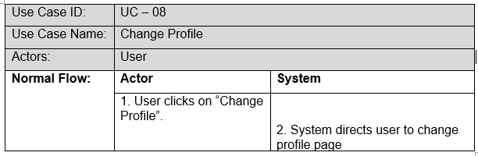
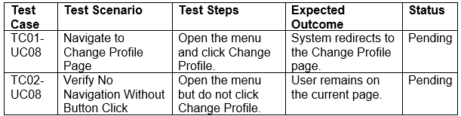
Use Case 08:
Developer: Qahar

Slide 11
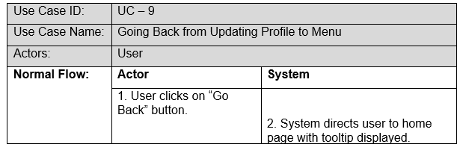
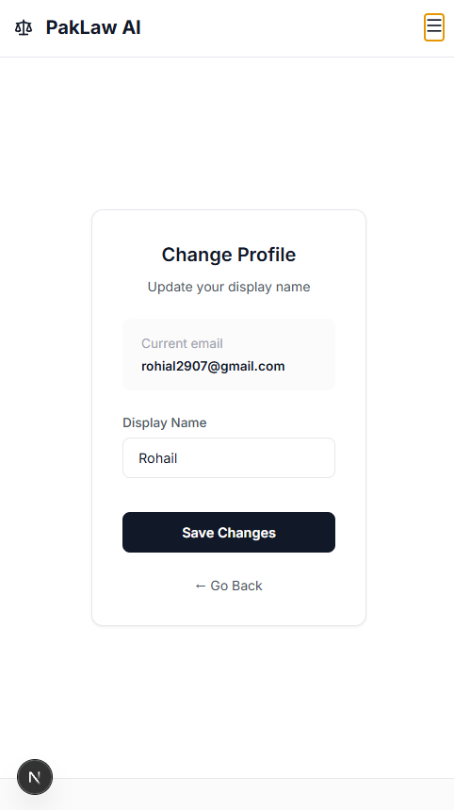
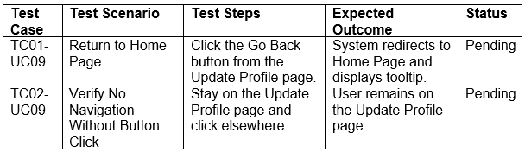
Use Case 09:
Developer: Qahar

Slide 12
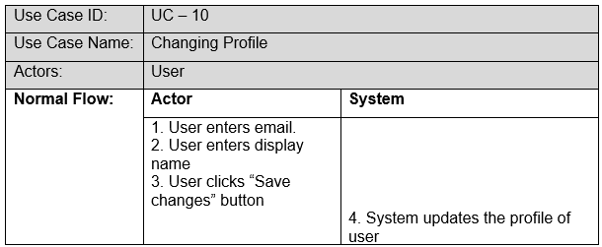
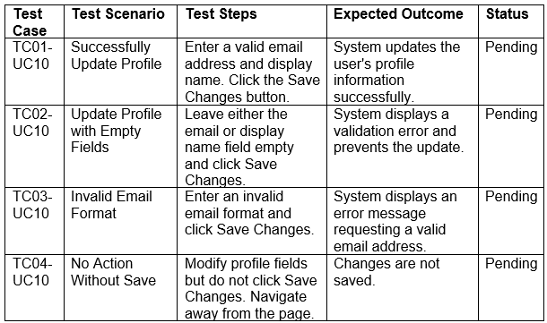
Use Case 10:
Developer: Qahar

Slide 13
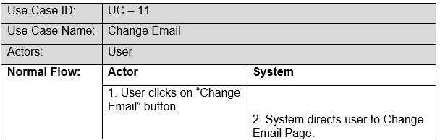
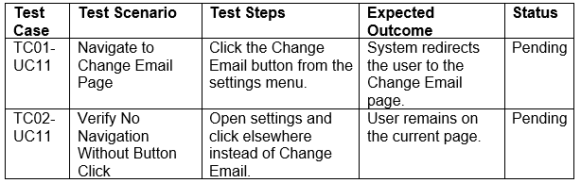
Use Case 11:
Developer: Noor

Slide 14
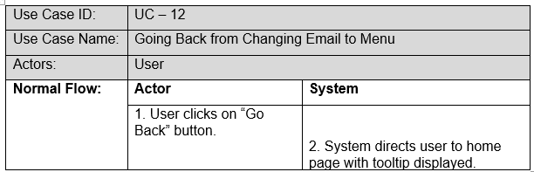
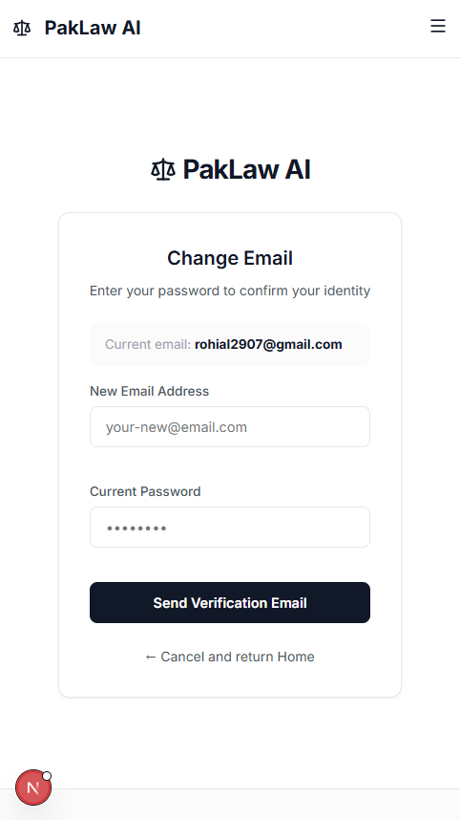
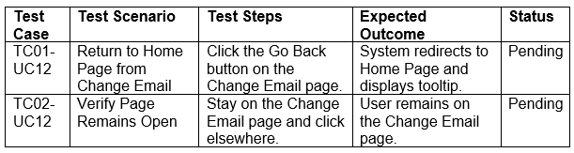
Use Case 12:
Developer: Noor

Slide 15
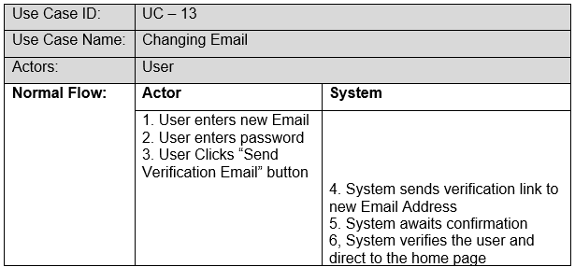
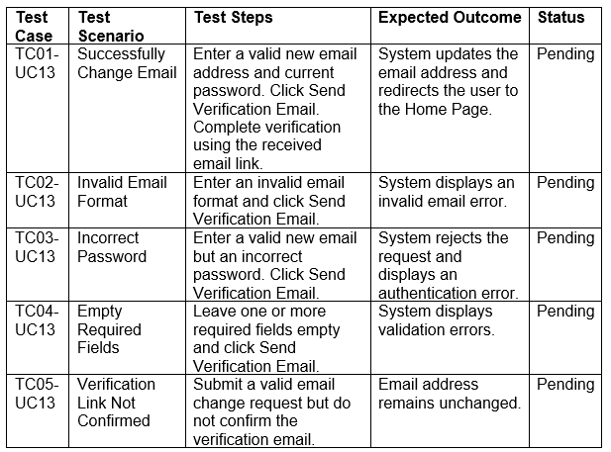
Use Case 13:
Developer: Noor

Slide 16
User Gmail:

Slide 17
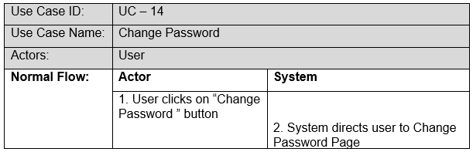
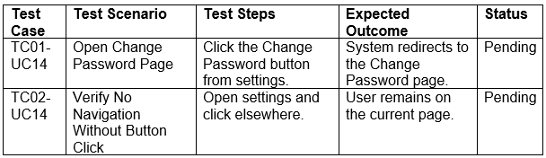
Use Case 14:
Developer: Noor

Slide 18
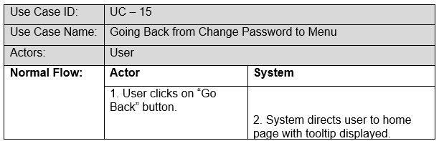
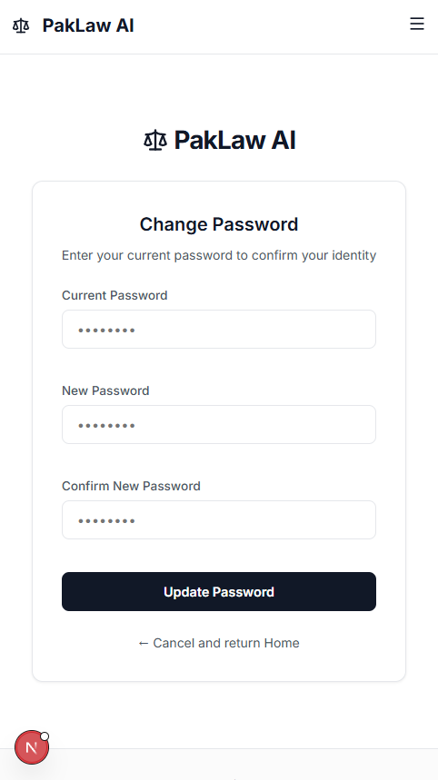
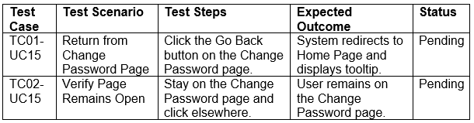
Use Case 15:
Developer: Noor

Slide 19
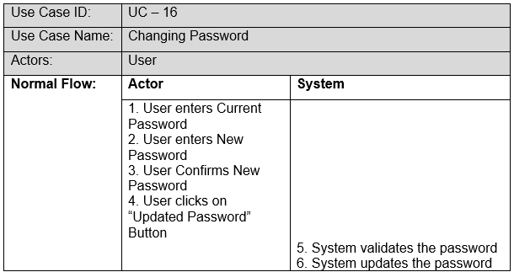
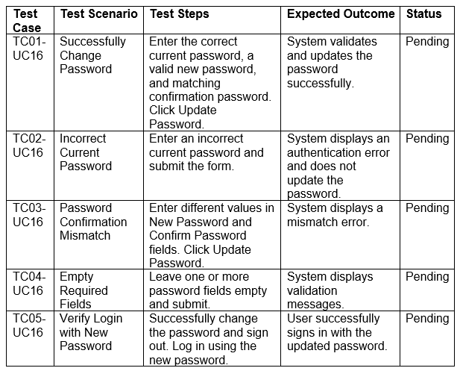
Use Case 16:
Developer: Noor

Slide 20
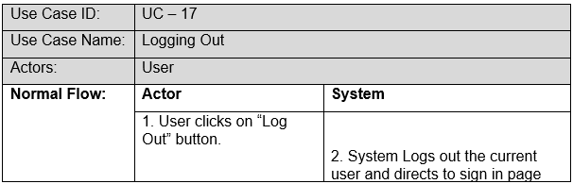
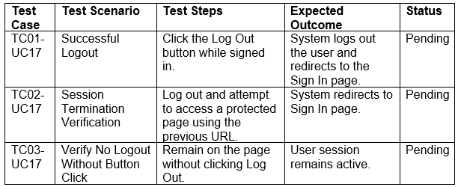
Use Case 17:
Developer: Noor

Slide 21
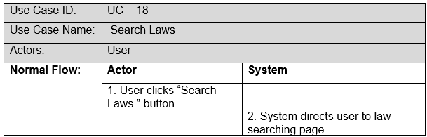
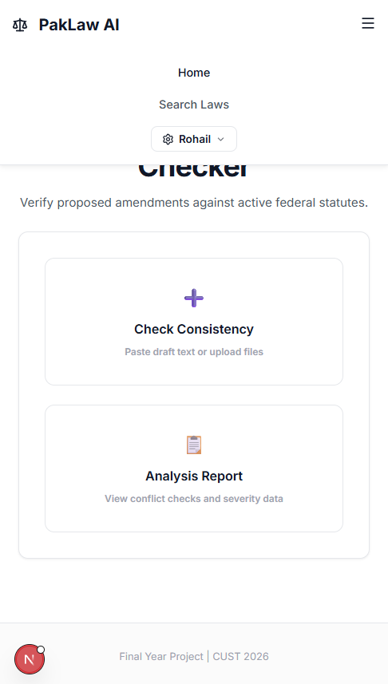
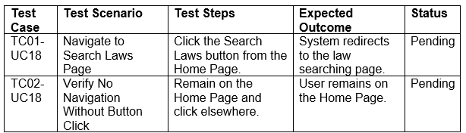
Use Case 18:
Developer: Noor

Slide 22
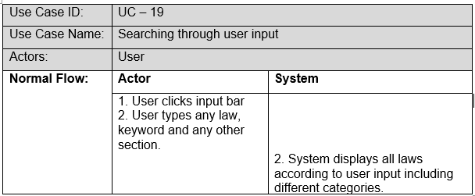
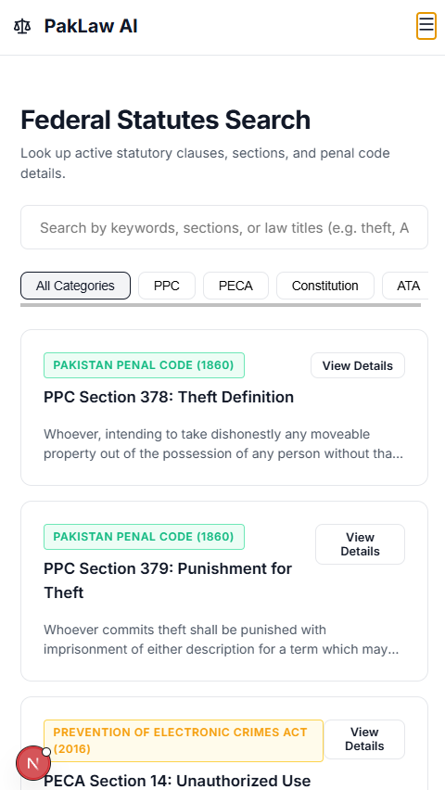
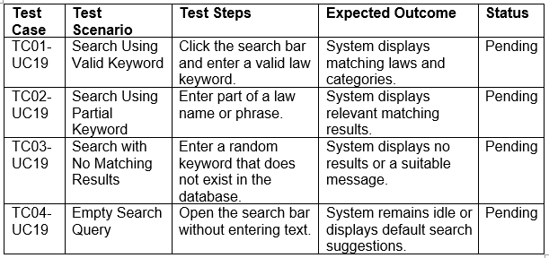
Use Case 19:
Developer: Noor

Slide 23


Use Case 20:
Developer: Noor

Slide 24


Use Case 21:
Developer: Noor

Slide 25



Use Case 22:
Developer: Noor

Slide 26



Use Case 23:
Developer: Noor

Slide 27



Use Case 24:
Developer: Rohail

Slide 28



Use Case 25:
Developer: Rohail

Slide 29



Use Case 26:
Developer: Rohail

Slide 30


Use Case 27:
Developer: Rohail

Slide 31



Use Case 28:
Developer: Rohail

Slide 32



Use Case 29:
Developer: Rohail

Slide 33



Use Case 30:
Developer: Rohail

Slide 34



Use Case 31:
Developer: Rohail

Slide 35



Use Case 32:
Developer: Rohail

Slide 36




Use Case 33:
Developer: Rohail

Slide 37



Use Case 34:
Developer: Rohail

Slide 38
THANKYOU !

